Slide 1
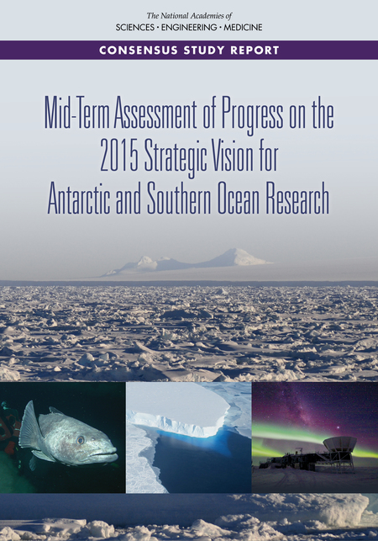
Webinar will begin shortly at
2 pm EDT/11 am PDT

Slide 2
Mid-Term Assessment of NSF Progress on the 2015 Strategic Vision for Antarctic and Southern Ocean Research
Oscar Schofield, Rutgers Univ., Chair
November 3, 2021

Slide 3

2015 National Academies Report
NSF should continue to support a core program of broad-based, investigator-driven research.
NSF should pursue the following as strategic priorities :
How fast and by how much will sea level rise? The Changing Antarctic Ice Sheets Initiative
How do Antarctic biota evolve and adapt to the changing environment? Decoding the genomic and transcriptomic bases of biological adaptation and response across Antarctic organisms and ecosystems.
How did the universe begin and what are the underlying physical laws that govern its evolution and ultimate fate? A next-generation cosmic microwave background program.

Slide 4

Mid-Term Assessment Study Task
In 2020, NSF asked the National Academies to convene a committee to:
Assess progress in addressing research goals outlined in the 2015 report
Identify significant recent advances in scientific understanding and/or technical capabilities that present important new opportunities for progress in addressing the mission of NSF’s Antarctic Sciences Section.
For the three priority research topics:
Address any current implementation challenges in advancing these research areas.
Suggest strategies to overcome these implementation challenges

Slide 5
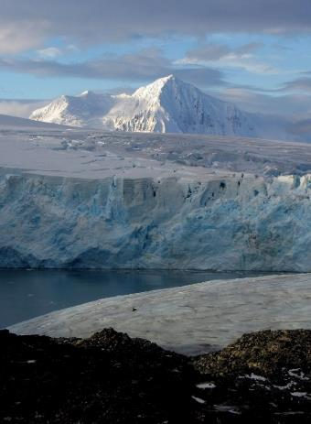
Study Process
Information gathering:
  NSF presentations (Nov. ‘20)
  8 community web conferences each focused on a single priority or core (Jan.-Mar. ‘21; ~180 attendees total)
  Written input from NSF in response to committee questions
Closed virtual meetings for committee deliberation (10 full committee meetings, numerous subgroup meetings)
Peer-review
Consensus report released Oct. 28
Credit: Janice O'Reilly; nsf.gov

Slide 6
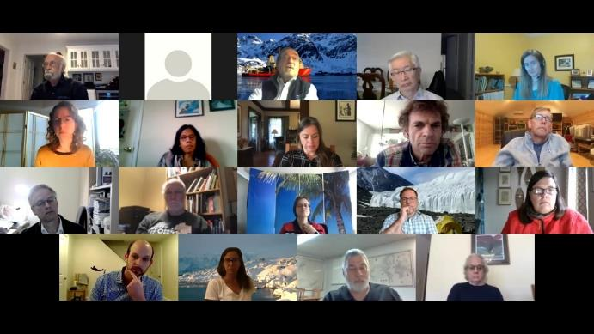
Committee
OSCAR M. E. SCHOFIELD, chair, Rutgers University*
AMY BARGER, University of Wisconsin, Madison
KELLY BRUNT, University of Maryland (until 6/21)
ROBERT CLAUER, Virginia Tech
INDRANI DAS, Columbia University
WILLIAM DETRICH, Northeastern University
MICHAEL GOOSEFF, University of Colorado
KENNETH M. HALANYCH, Auburn University
MARK HALPERN, University of British Columbia*
ALISON MURRAY, Desert Research Institute*
ERIC RIGNOT, University of California, Irvine
AMELIA SHEVENELL, University of South Florida
HELIO TAKAI, Pratt Institute
TERRY WILSON, Ohio State University*
ERIC WOLFF, University of Cambridge*
*attending briefing

Slide 7
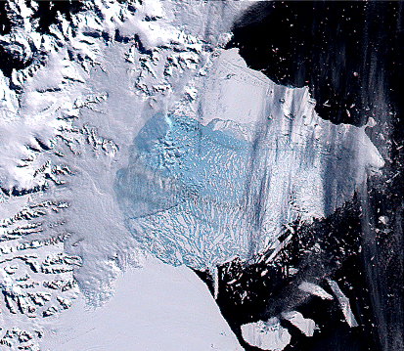
  Priority I:How fast and by how much will sea level rise? The Changing Antarctic Ice Sheets Initiative i. Understanding why ice sheets are changing now and how they will change in the future, and ii. Using multiple records of past ice sheet change to understand rates and processes.
Science questions urgent, complex, and essential to global adaptation planning; require research initiatives that are ambitious in vision and funding
  IGTC making important progress
  Work on past change proceeding at slower pace
Source; NASA
Notes:
Despite the important progress to date, the potential magnitude of the threats to humans posed by Antarctic ice sheet collapse demands a more aggressive, comprehensive, and ambitious research approach; the scientific response to this immense challenge should be commensurate with the task at hand.

Slide 8
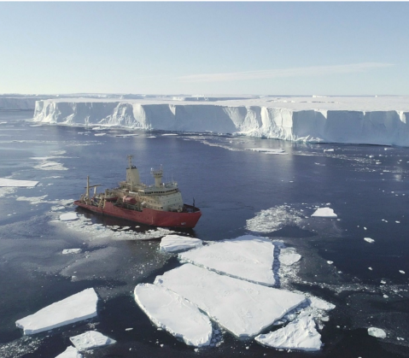
Priority I: Key Challenges
Magnitude of science goal
Logistical challenges
  Limited logistical capacity and funding slowing implementation of Priority I.
Insufficient integration across scientific community
  Paleo vs. current processes
  Terrestrial vs. marine vs. modeling

Slide 9
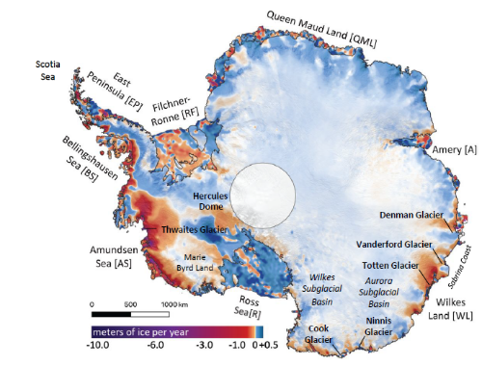
Priority I: Recommendations
To advance Priority I, NSF should:
Take a leadership role in initiating additional international and interagency partnerships to enable ambitious science campaigns
Consider expanding beyond the ITGC to include the Wilkes Land sector of East Antarctica
  Even greater potential contributions to SLR than West Antarctica

Slide 10
Priority I: Recommendations (cont.)
To advance Priority I, NSF should:
Expand and continue international Thwaites Glacier region research
Issue a call for proposals to study past ice sheet change
  Would address perceived lack of urgency
Increase support for interdisciplinary research and modeling efforts
Notes:
It is very difficult to envision, however, that most of the key scientific questions will be addressed with only a couple of field campaigns to a sector of Antarctica that is changing very rapidly and has never been investigated at this level of detail. Additional years of study of this sector by an expanded international community are warranted given our current state of knowledge of the underlying processes and rates of ice sheet loss

Slide 11
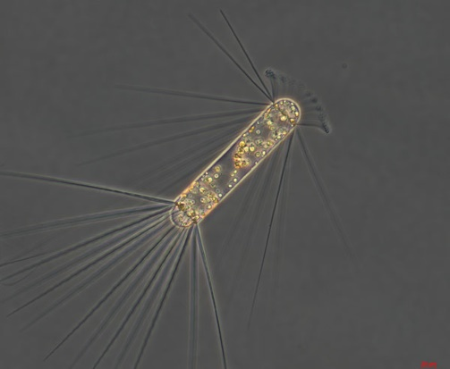
Priority II: Using Omics to Understand How Antarctic Biota Evolve and Adapt
Compelling and realistic scientific objective with substantial opportunities ahead
Progress falls short of the original Priority II strategic initiative envisioned by NASEM (2015).
  Promotion limited and slow, did not attract attention of many relevant researchers

Slide 12
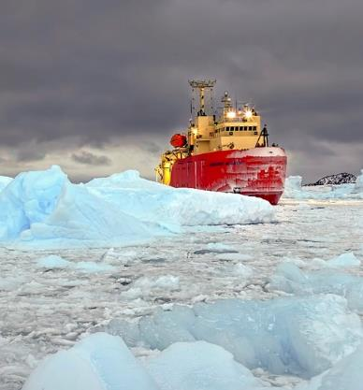
Priority II: Key Challenges
Most work by individuals or small teams; lack of coordinated community vision or research initiatives
Rapidly evolving bioinformatics platforms and research strategies
  Lack of coordinated data and standards can lead to incomplete genomes and transcriptomes that are of little value in a comparative sense.
Access to organisms challenging
Source: NSF

Slide 13
Priority II: Recommendations
To advance Priority II, NSF should:
Issue a targeted call for proposals with clear and updated objectives
  Including sequencing of phylogenetically informed, ecologically important organisms/assemblages
  New genome collections would set stage for further studies
Emphasize community building and partnerships
  Workshops to develop strategy to prioritize taxa and species assemblages for omics analyses
  Partnerships for omics resources, infrastructure sharing, and access, including genome centers and initiatives

Slide 14
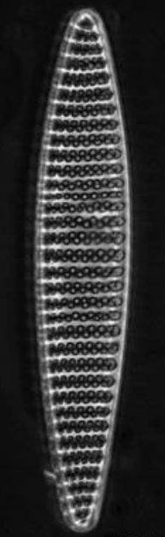
Priority II: Recommendations (cont.)
Evaluate opportunities to enhance access to organisms, samples and data and address logistics challenges that limit access:
  Improvement of collection, curation, and U.S.-based sample storage
  Creation of facilities to cultivate/maintain Antarctic organisms;
  Enhancement of temporal and geographic access to Antarctica and the Southern Ocean; and
  Upgrades to Antarctic research facilities to allow real-time genomic analyses and facilitate more process-oriented research.
Improve access to data, metadata through improved data management

Slide 15
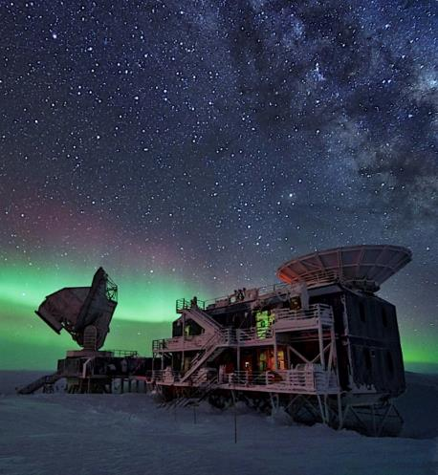
Priority III: How did the universe begin? A next-generation cosmic microwave background program
CMB research at the South Pole has been flourishing for many years
Significant scientific progress in the design of CMB-S4, considered the global future of CMB research
  Long-term project, installation targeted for 2029
  Large, effective scientific collaboration, self-organized
  Funding from DOE and other NSF divisions
Notes:
High impact results via South Pole Telescope and BICEP/Keck experiments
Continued advancements underway (BICEP Array, TMA)

Slide 16
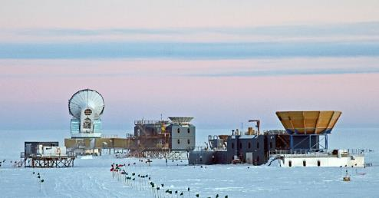
Priority III: Key Challenges
Inadequate funding and planning for logistical support pose a threat to rate of progress
  Large concern for CMB-S4, which requires deployment of towers and telescopes and power plant upgrade
  Current logistics discussions inadequate to support science planning
Source: NSF

Slide 17
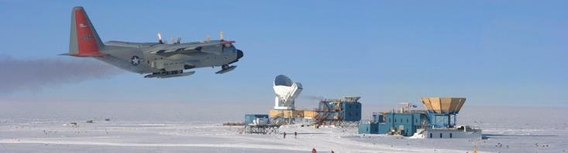
Priority III: Recommendations
Effective communication and collaboration between NSF logistics and CMB science planning is essential for timely implementation
NSF should support timely two-way communication between NSF logistics and scientists, in which trade-offs between support options are explored
Coordination needs to occur earlier in the planning process

Slide 18
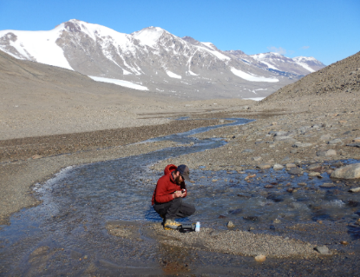
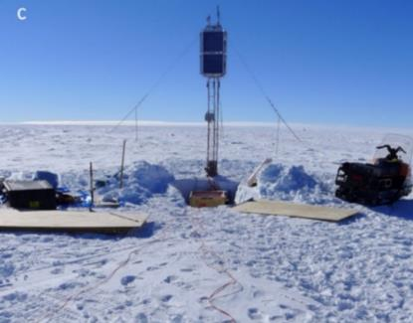
Broad-Based Investigator Driven Antarctic Research
NSF appears to have sustained a broad-based core research program, although logistical constraints have affected the available support for science.
  Committee could not detect a clear change in breadth or total funding
  Recent trend toward larger, fewer projects
  Projects have been delayed or declined due to logistical constraints; particularly challenging to early career researchers
Notes:
2015 report said NSF should “continue to support a core program of broad-based, investigator-driven research” (NASEM, 2015). The report suggested “that NSF’s traditional broad-based research support strategies be balanced with more directed, larger-scale efforts aimed at ensuring that a critical mass of human and financial resources is concentrated on meeting key research goals over a limited period of time.”
DEFINE CORE: For this review, the committee defines the broad-based core program as NSF-funded research in Antarctica that addresses topics outside the three priority areas discussed in the previous chapters. Awards include large programs, such as the IceCube Neutrino Observatory, the Long-Term Ecological Research (LTER) program, and Southern Ocean Carbon and Climate Observations and Modeling (SOCCOM), along with many smaller single investigator and small team efforts.
See https://soccom.princeton.edu.

Slide 19
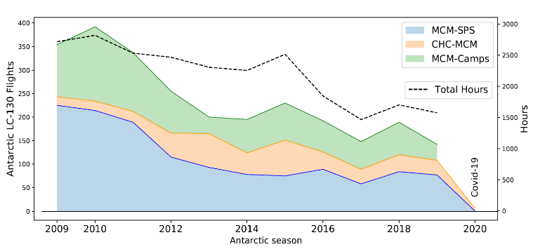
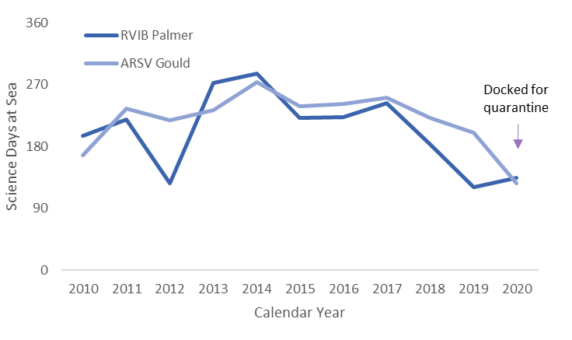
Cross-Cutting Issues
Across all strategic priorities and the core program, logistical considerations are limiting the pace of research and the geographic breadth of science.
Notes:
Increasing aircraft costs have recently contributed to a reduction in the number of missions and flight hours, creating challenges for deep-field access. The scientific community is deeply concerned about sustaining an adequate Antarctic science program given these logistical constrains, the age of the USAP research vessels, and the lack of a polar-class icebreaker. Strong proposals are being rejected based on insufficient logistical capacity, and funded projects are being seriously delayed.

Slide 20
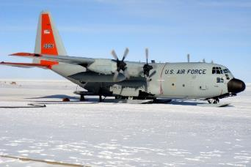
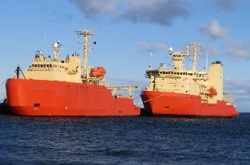
Cross-Cutting Issues: Logistics
NSF should conduct a transparent review of logistical support capacity for the Antarctic Sciences program.
  review anticipated resource demands from the strategic priorities and other research initiatives
  identify resource constraints and competing demands
NSF should improve communication and coordination between OPP, logistics managers, and the scientific community
  consider developing a forum to engage the broad science community in discussions of logistical realities
  facilitate scientific community input on priorities, support strategies, and trade-offs
Source: NSF
Notes:
Such a review will
Increase transparency with investigators and encouraging proposals aligned with logistical realities
motivate strategies, such as partnerships, to reduce logistical constraints and balance demands

Slide 21
Cross-Cutting Issues
To address serious shortfalls in diversity, equity, and inclusion (DEI) in Antarctic Sciences, NSF should identify robust, evidence-based strategies to support systemic community change.
  work with DEI professionals to promote diversity through clear expectations in funding announcements, reporting requirements, and the sharing of best practices
  actively seek to broaden the pool of scientists working in Antarctica
  support mentoring of early-career scientists and others new to polar science
Notes:
The committee applauds recent NSF and individual Antarctic science team efforts to address sexual harassment in field-based programs.
Participation from all members of the Antarctic scientific community will be needed

Slide 22

Cross-Cutting Issues
NSF Antarctic Sciences should continue to develop and leverage international partnerships to increase science opportunities
NSF should encourage organizational and collaborative activities to foster integrative and interdisciplinary advances.
Source: NSF

Slide 23
Summary
NASEM (2015) priorities remain timely and urgent, but progress uneven
NSF could promote progress through:
  special calls for proposals, efforts to foster collaboration, increased partnerships, evidence-based strategies to enhance diversity
Logistical capacity was a major impediment to pace and scope of progress
  NSF should conduct a review of logistical capacity
  Improve communication and transparency with scientists and seek input

Slide 24

More Resources
Full report at http://www.nap.edu/
Additional resources under “Resources” tab:
  4-page report in brief
Final book to be printed in late 2021

Slide 25
Questions?

